Slide 1
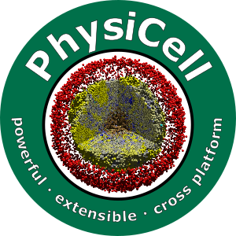

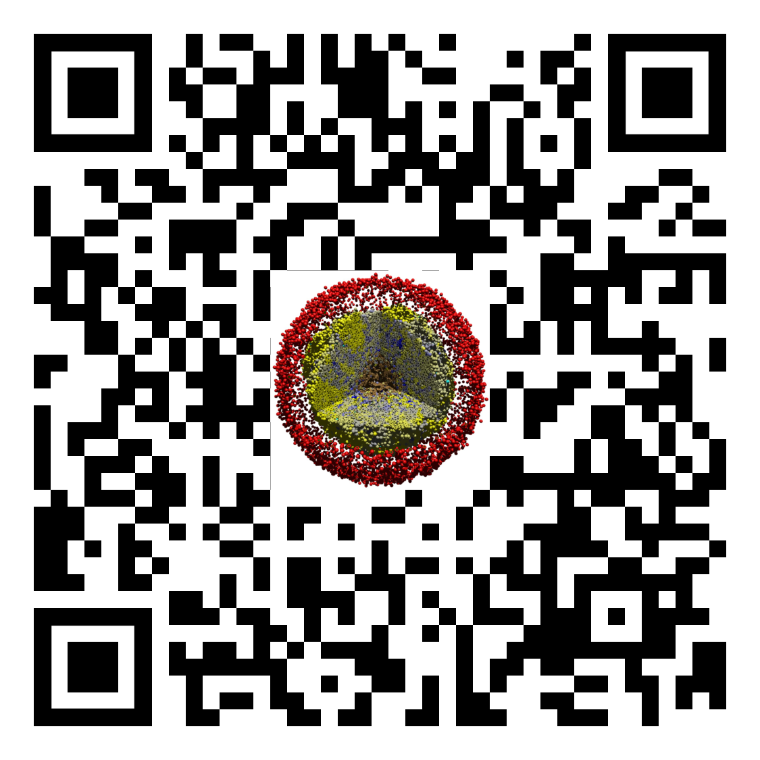
Lesson 2: How to use a PhysiCell nanoHUB app
Slides, videos, links and more:
https://github.com/physicell-training/02-How-to-nanoHUB
Paul Macklin, Ph.D.
@MathCancer
last updated: November 13, 2019

Slide 2
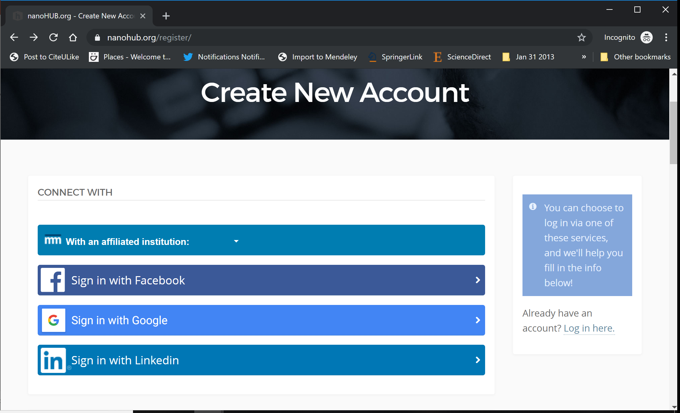
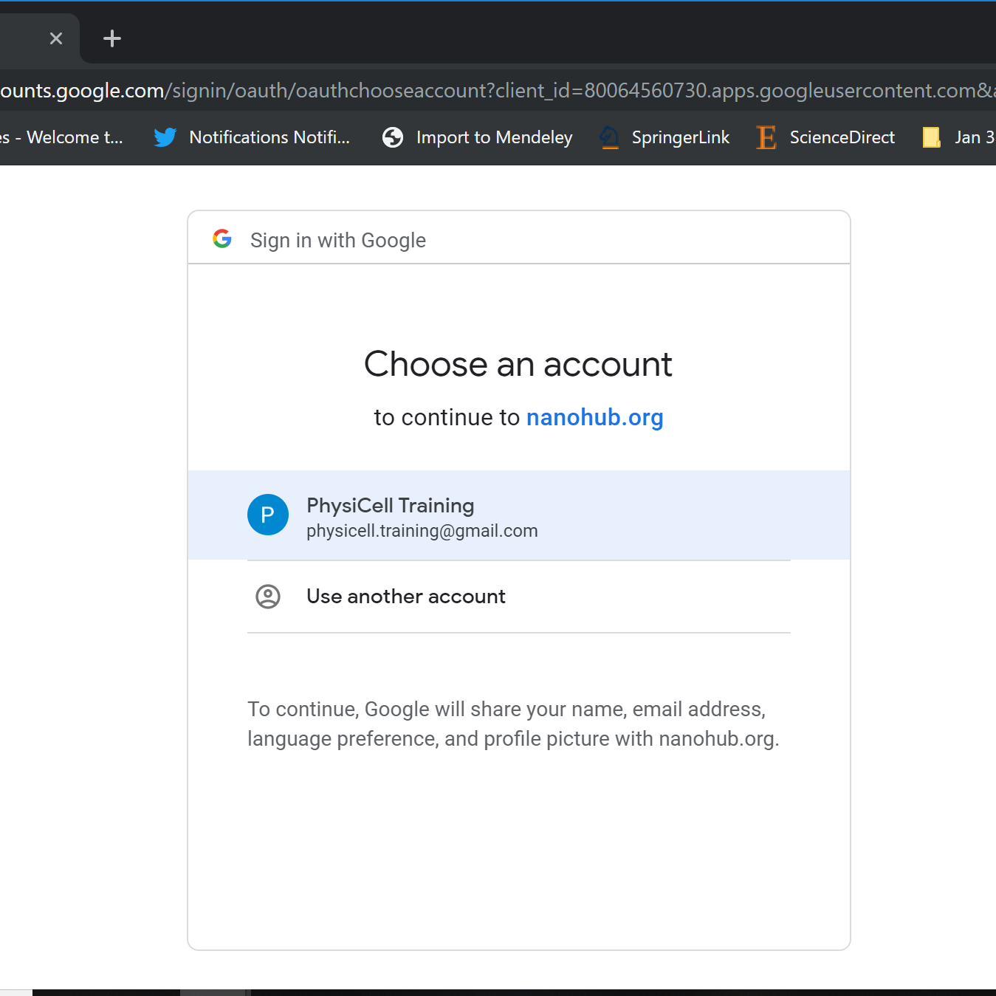
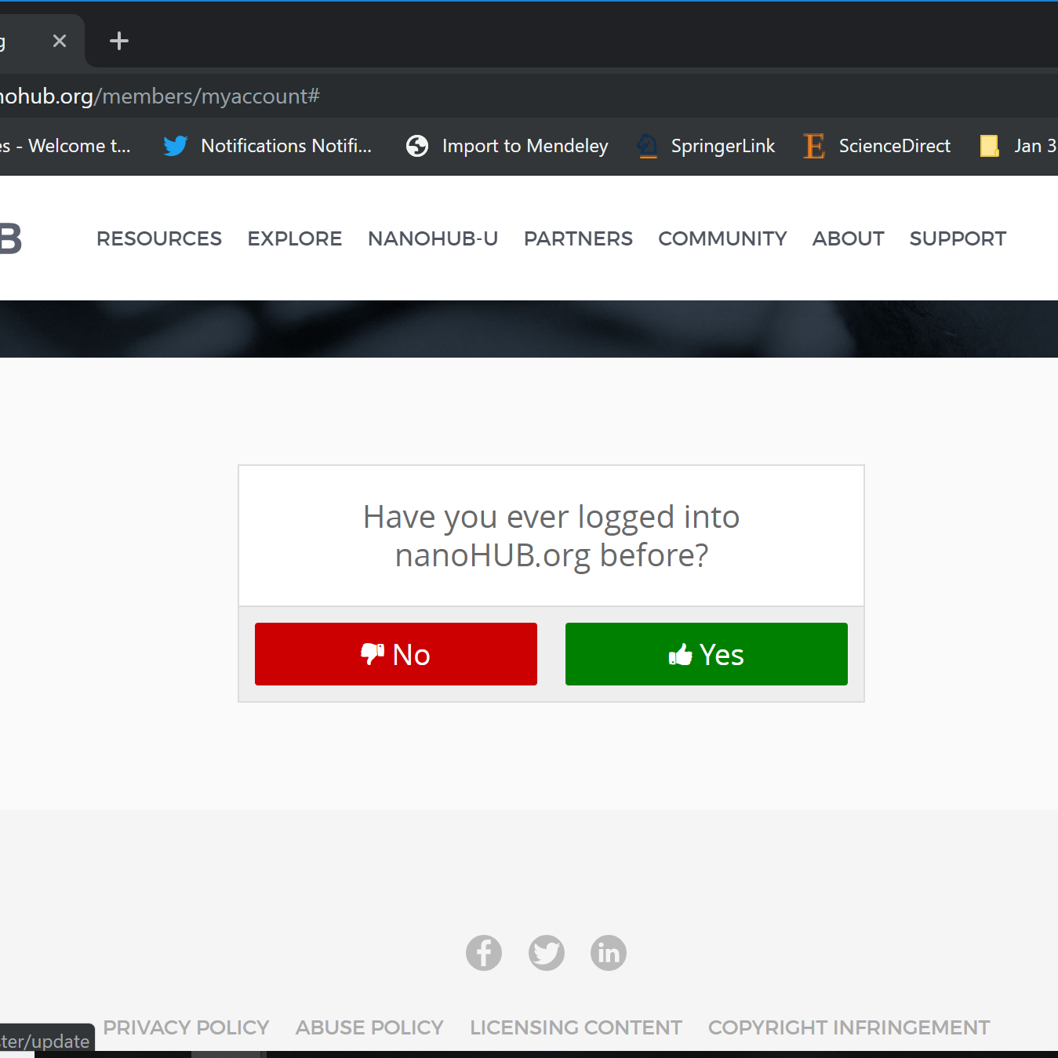
nanoHUB Account
These tutorials use cloud-hosted PhysiCell models on nanoHUB.org.
nanoHUB is free, but it requires a one-time registration.
Steps:
Visit https://nanohub.org/register
Choose "Sign in with Google"
Choose a Google account
Click "No" (so it doesn't try to associate with some other nanoHIB account)
Finish filling in details, and you're done!
Use your google account for future logins.
2
3
4

Slide 3
Goals
Many of the PhysiCell lessons are paired with educational microapps: targeted cloud-hosted models designed to illustrate a core PhysiCell concept.
All PhysiCell-powered nanoHUB apps share common features.
This brief lesson will walk you through those features.

Slide 4
Tools versus Apps
After considerable debate, the nanoHUB community arrived at these definitions:
A tool is an application with broader feature sets and less constrained use cases. A tool tends to require more extensive training to understand the full feature set.
Future PhysiCell-powered nanoHUB resources may be tools if they allow general-purpose modeling using PhysiCell as the engine.
An app is purpose-driven model or constrained tool with relatively constrained and focused use cases. Users can generally learn an app in one or two unguided sessions.
Most PhysiCell-powered nanoHUB resources are apps.
There may be blurred distinctions between tools and apps in some cases, such as PhysiCell apps that can simulate a broad variety of nanotherapies.

Slide 5
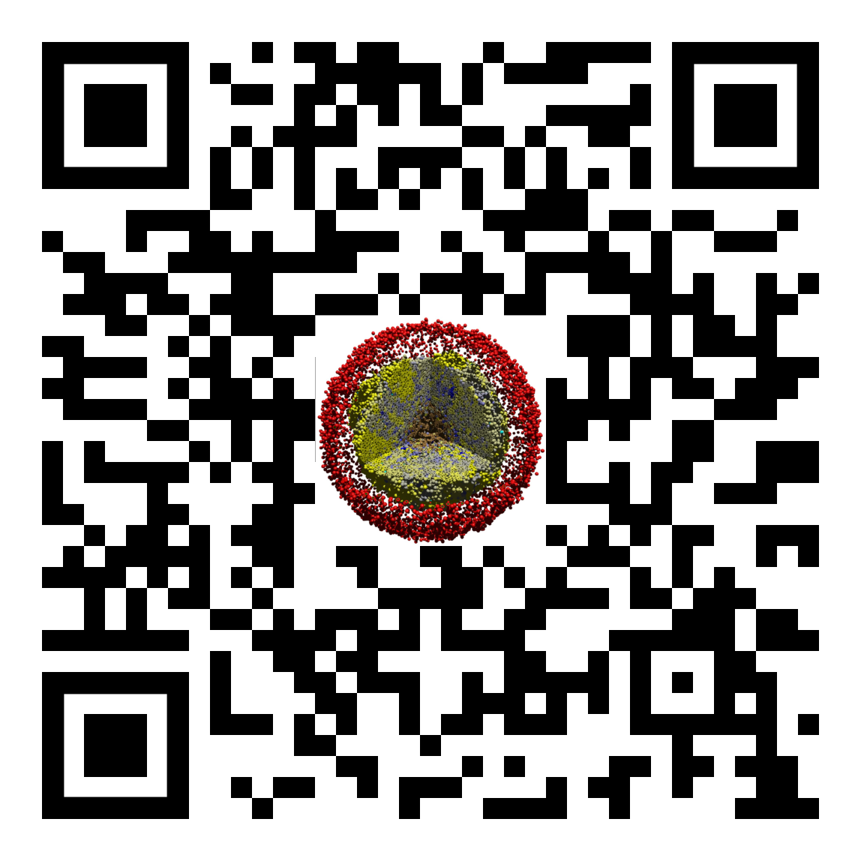
Sample nanoHUB app: biorobots
This sample model explores how engineered cells could be used as a multicellular cargo delivery system.
https://nanohub.org/tools/pc4biorobots
Director cells: Release a chemoattractant to guide delivery of cargo
Cargo cells: Release a chemoattractant to guide worker cells until they are attached.
Worker cells: When unattached to cargo, use chemotaxis to seek cargo cells and adhere to them. When attached to cargo, use chemotaxis to drag cargo towards directors for delivery.

Slide 6
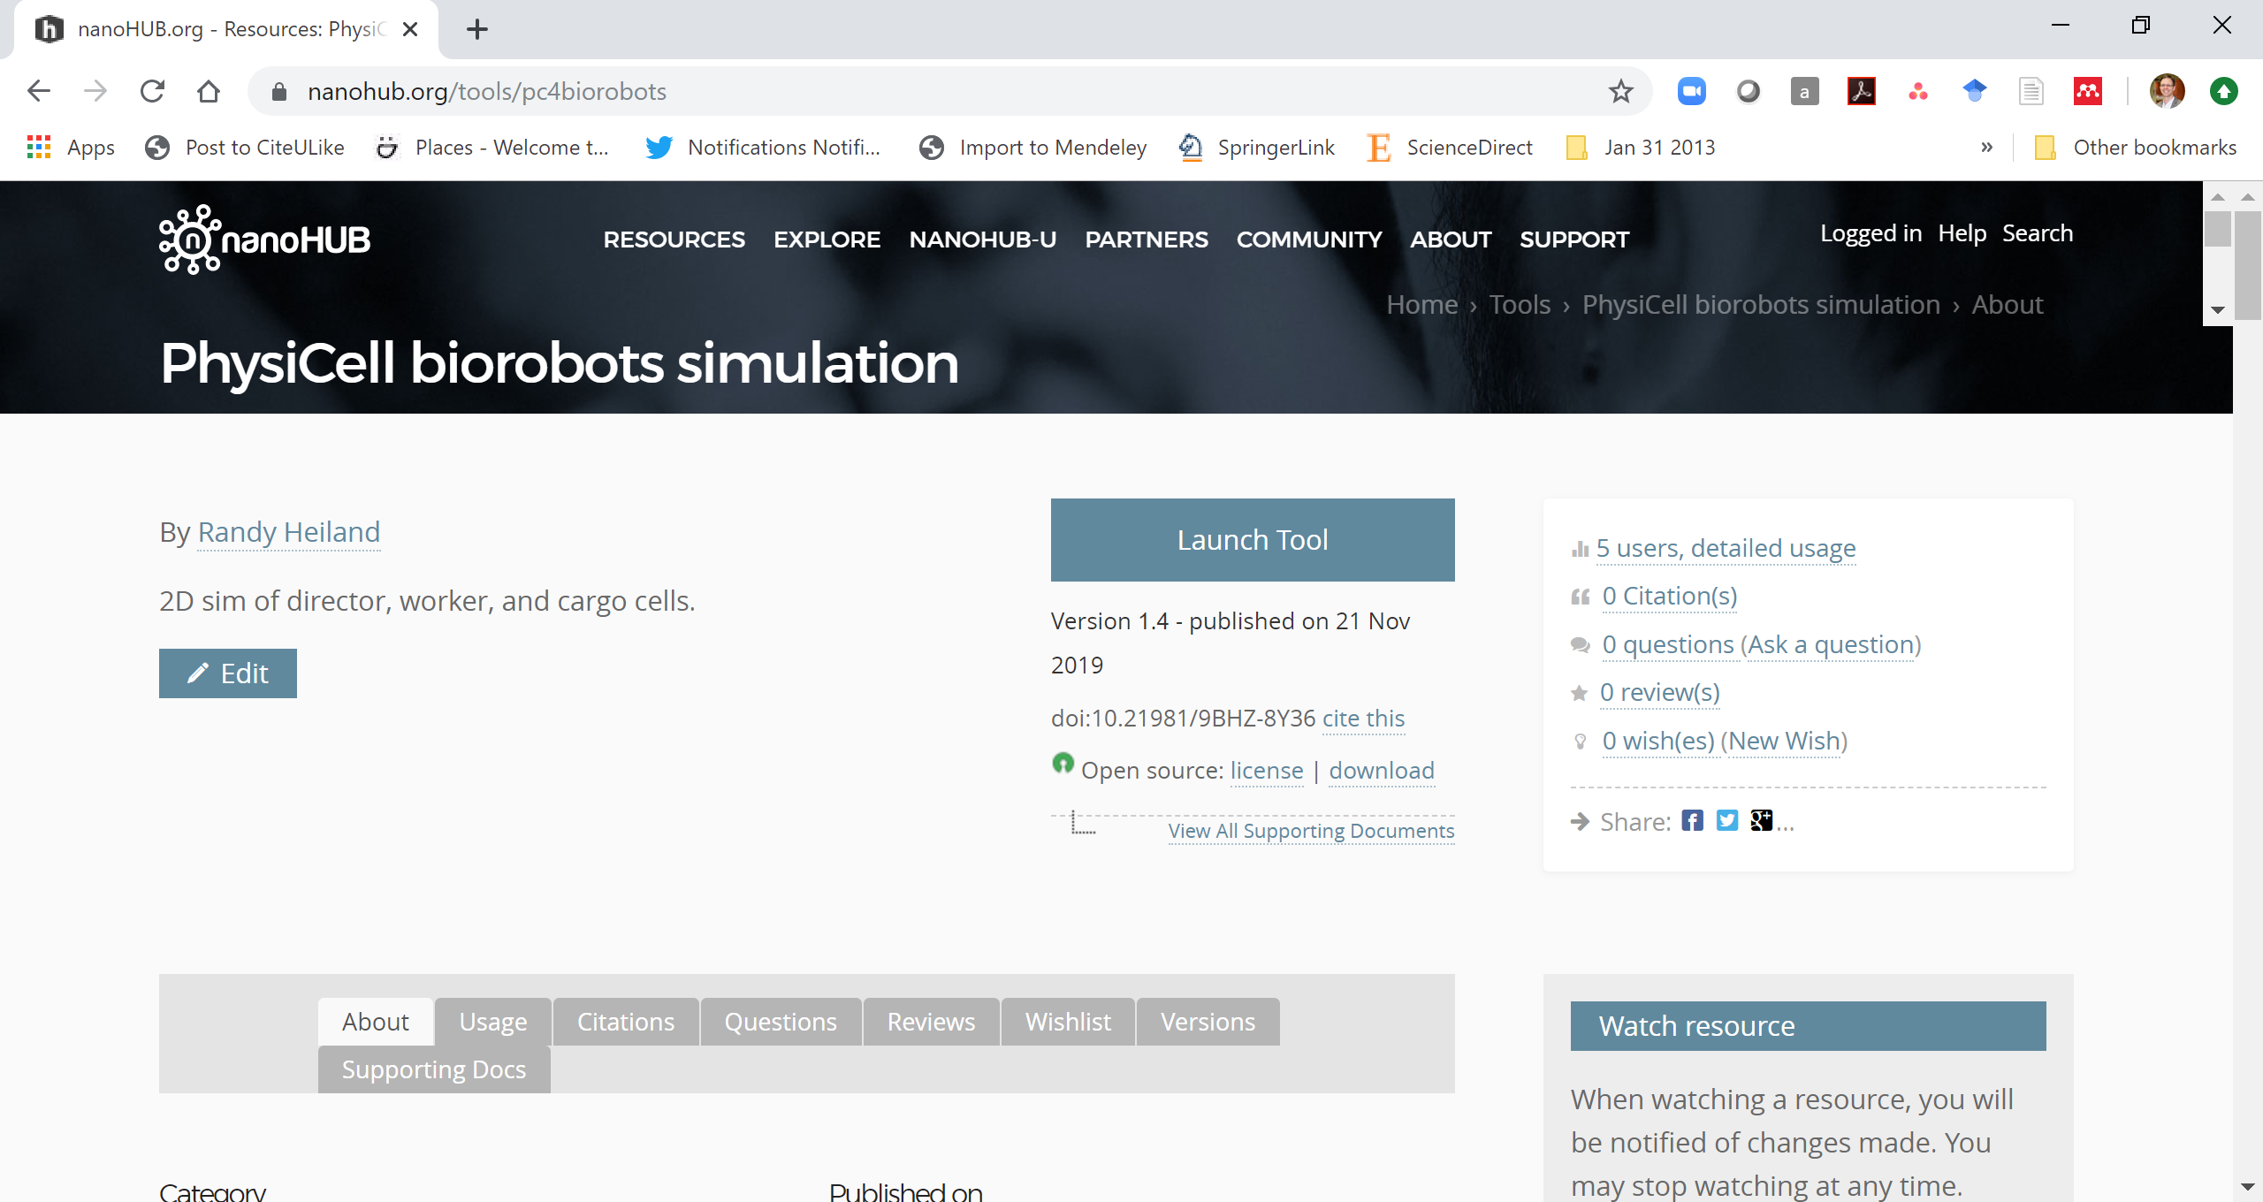
Splash screen and launching the tool
Each PhysiCell-powered nanoHUB app has a splash page:
Background information on the tool and model
Use metrics
Citation information
A LAUNCH TOOL button. Click this!

Slide 7
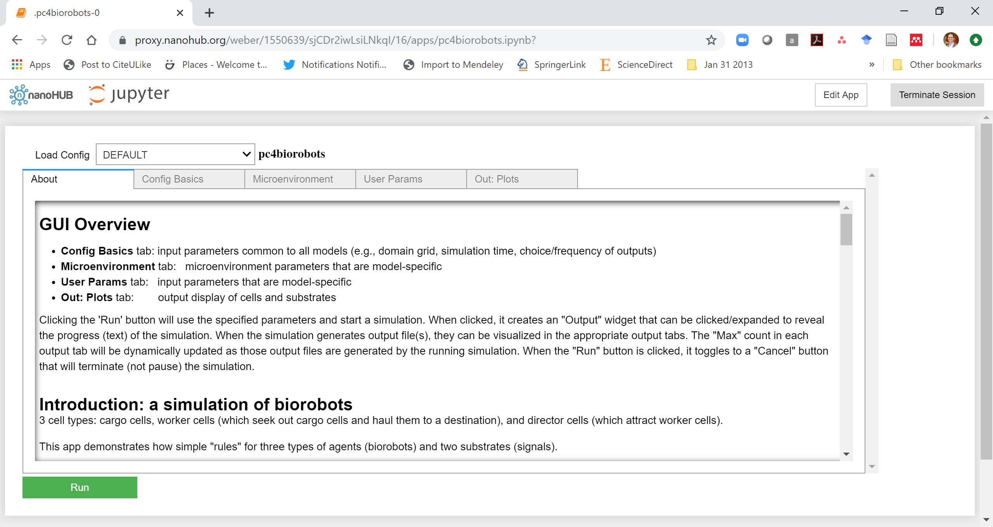
About
The about tab gives in-app documentation about the mathematics of the model:
background
diffusing substrates
key cell types and behaviors
This tab also describes the main user parameters of the model.

Slide 8
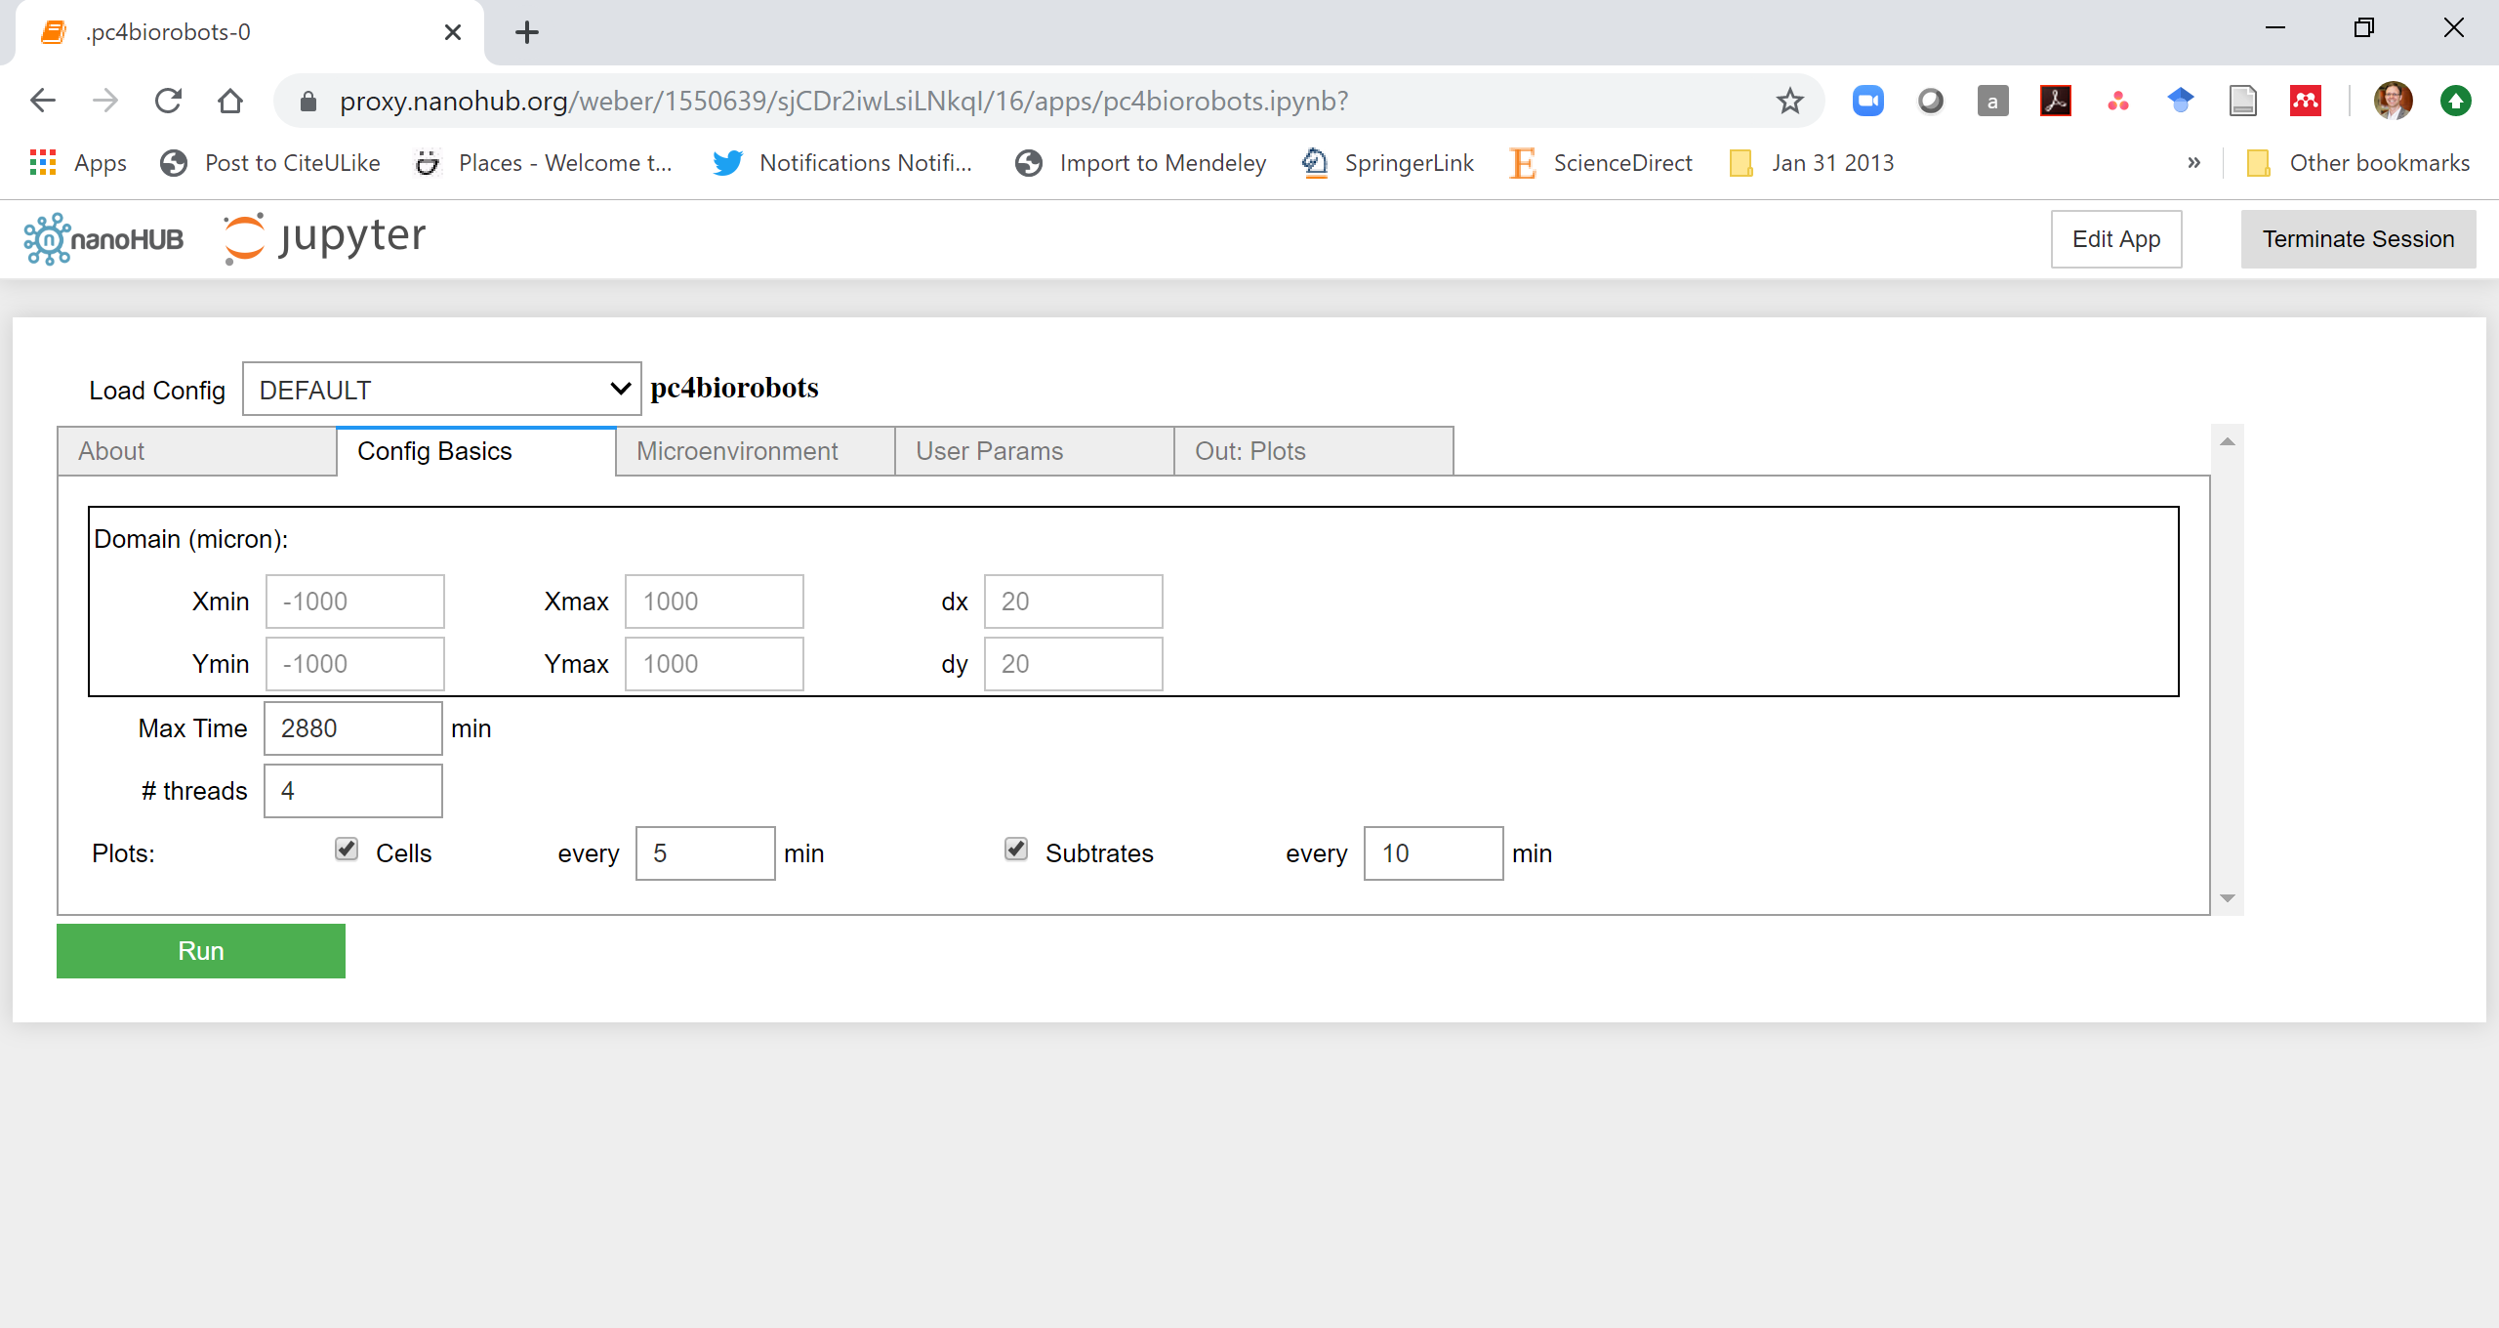
Configuration basics
The config basics tab lets you set up the simulation:
Set the domain size and spatial resolution
Might be disabled in some apps.
Set the final simulation time
Set the number of threads (capped at 4 on nanoHUB)
Specify how often to save cell plots
Specify how often to save diffusing substrate data

Slide 9
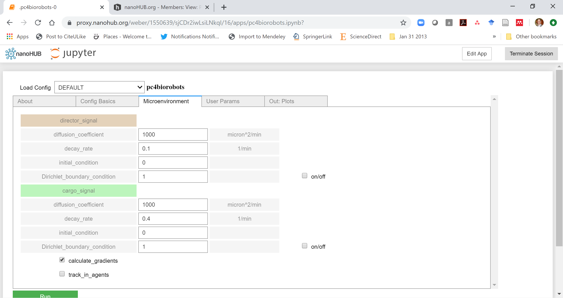
Microenvironment
The microenvironment tab lets you set diffusion options:
For each substrate, set:
diffusion coefficient
decay rate
initial condition
applied uniformly throughout the domain
Dirichlet boundary condition
applied uniformly to the boundary
"uncheck" to disable this and revert to Neumann (zero flux) conditions
Enable or disable calculation of substrate gradients
needed for cell chemotaxis
Enable or disable full tracking of internalized substrates in each cell
needed for some models

Slide 10
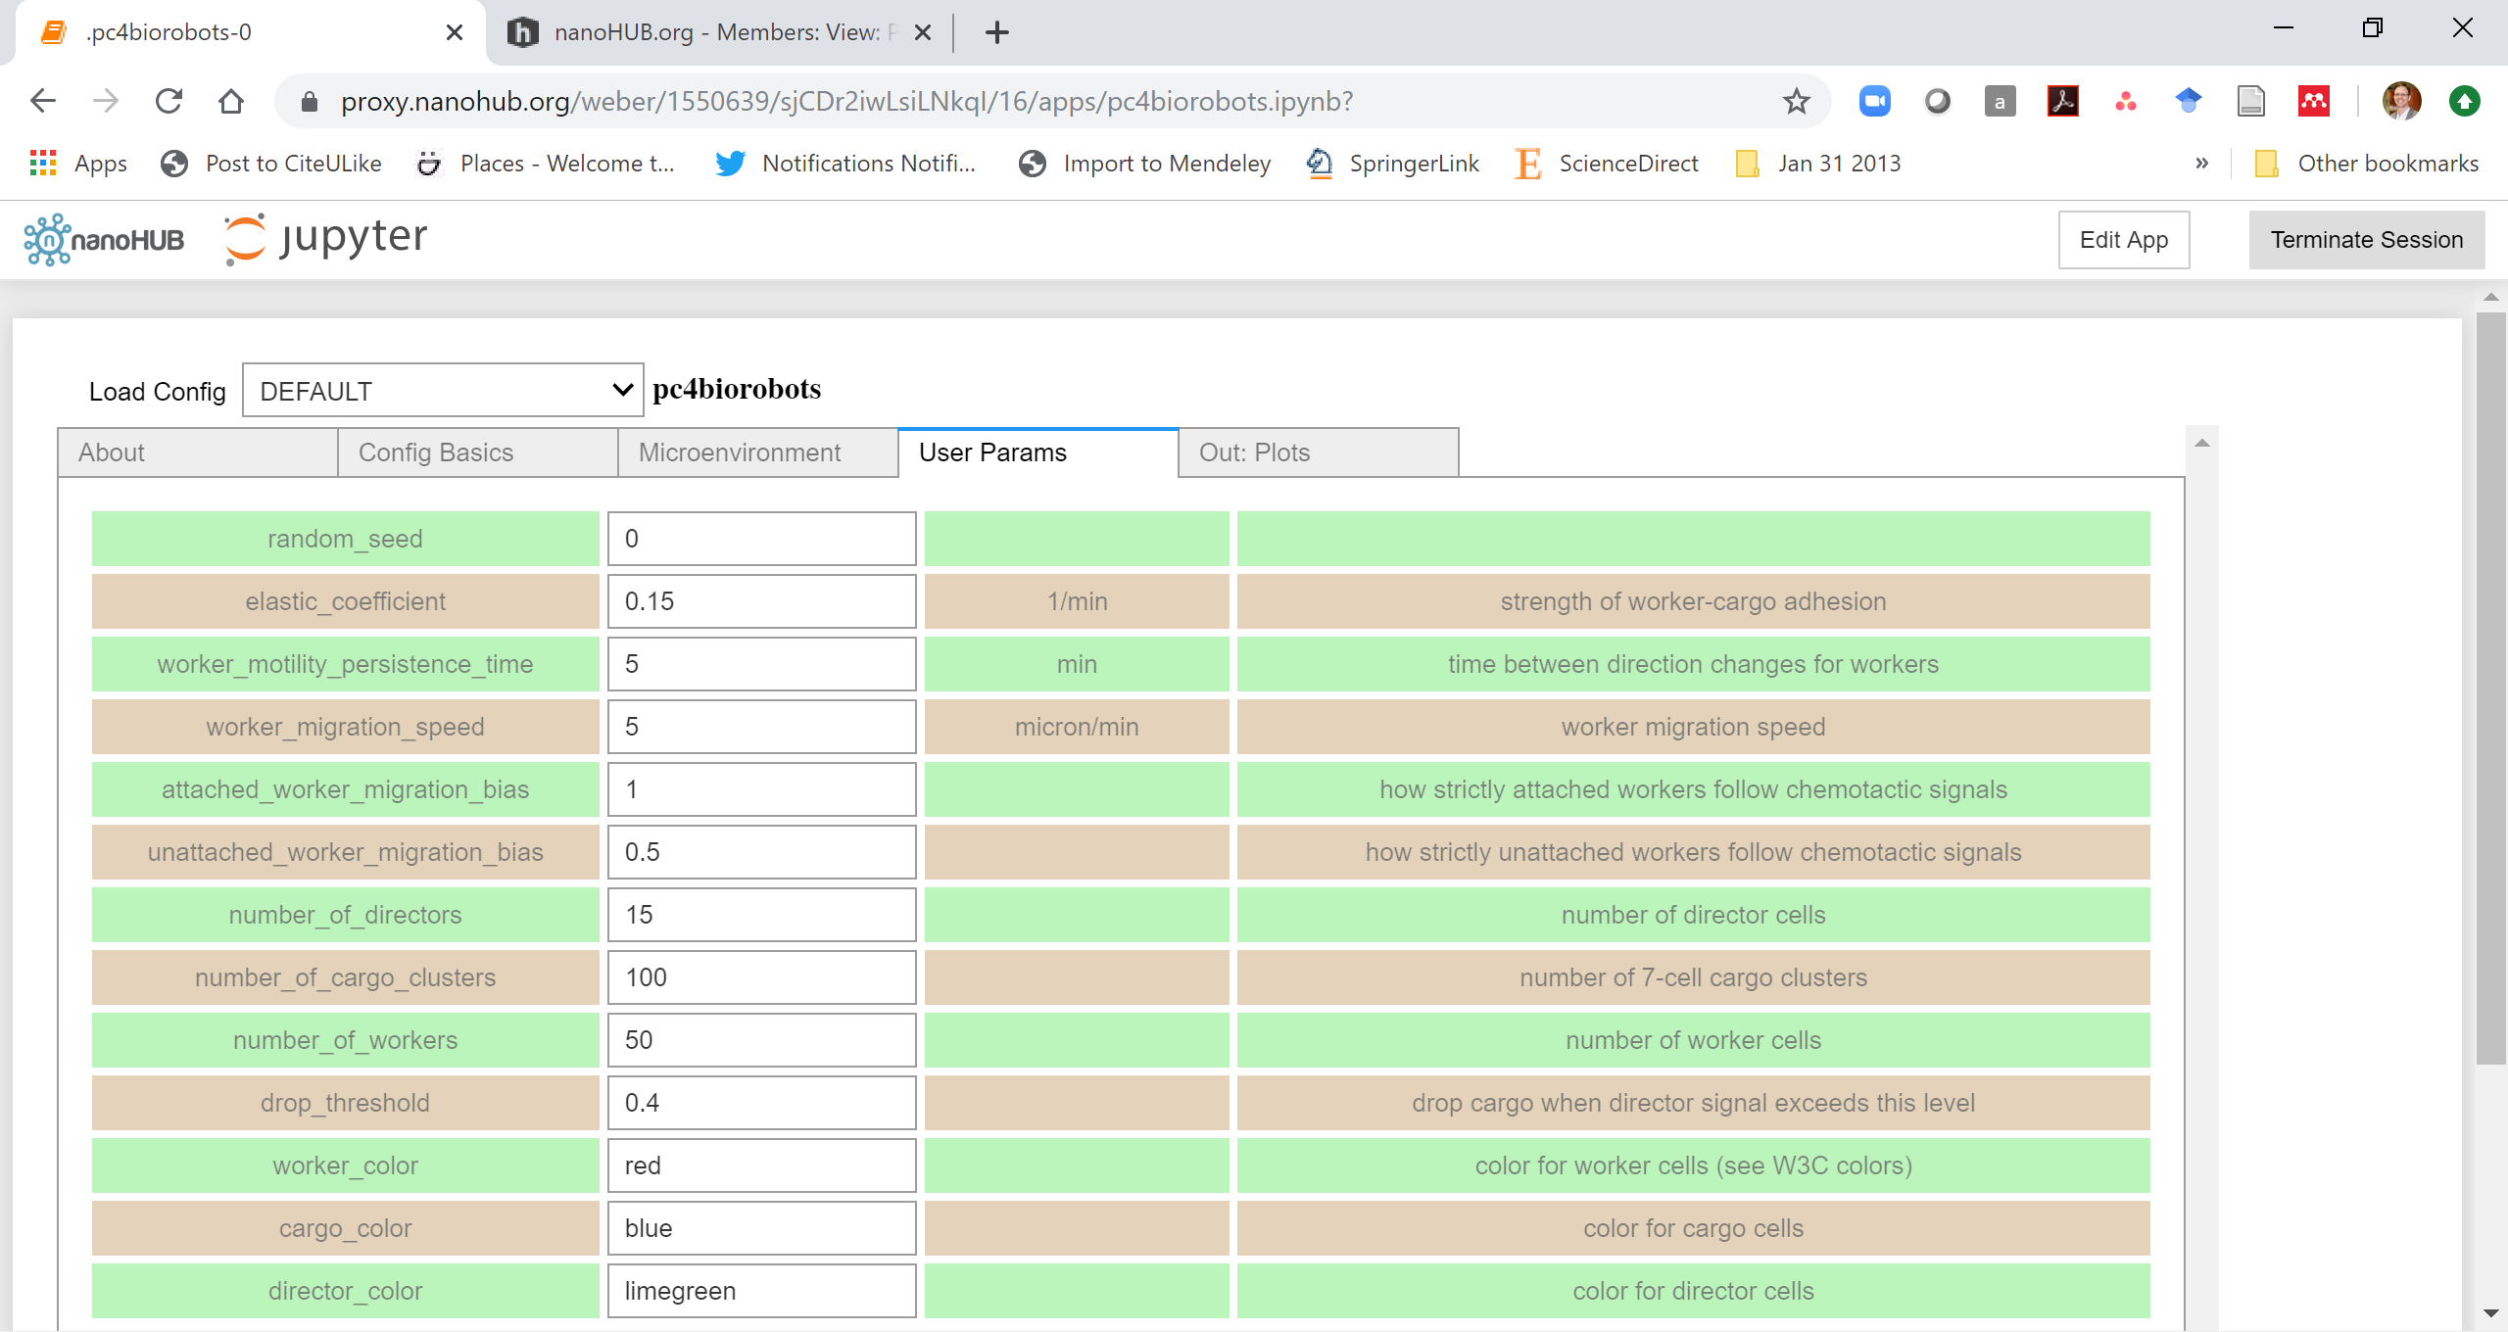
User parameters
The user parameters tab is where you set parameters that are specific to the app.
Each row is a parameter:
parameter name
parameter value
units
short parameter description
Consult the about tab for more mathematical information on the parameters

Slide 11
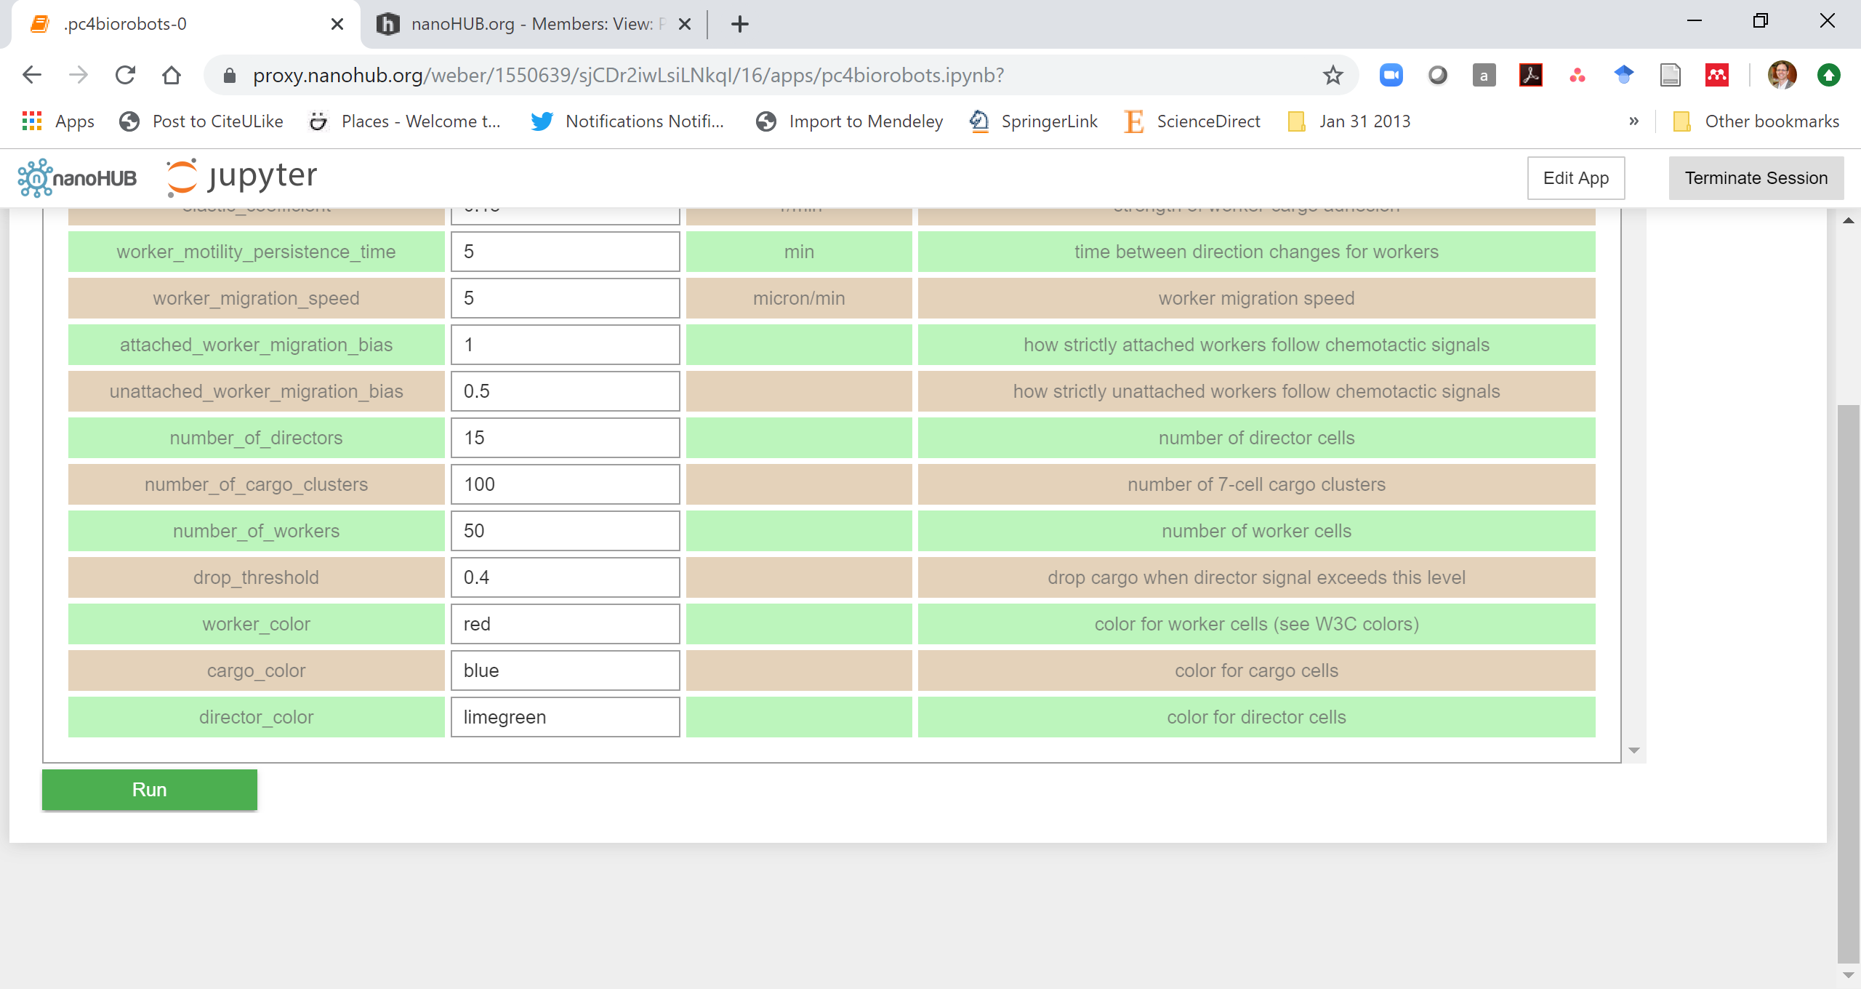
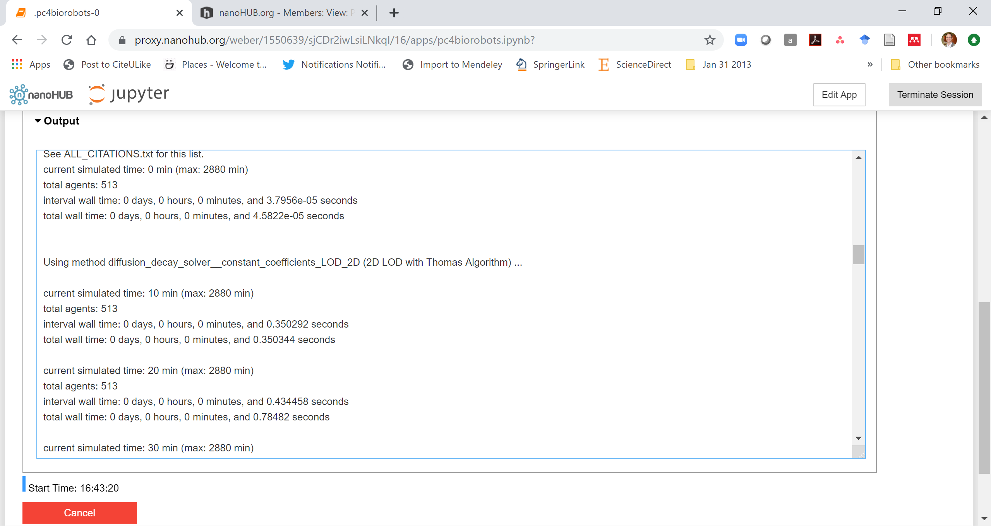
Running
Once ready, click Run .
The standard model outputs will start appearing below
Click Cancel . to end early and choose new parameters

Slide 12
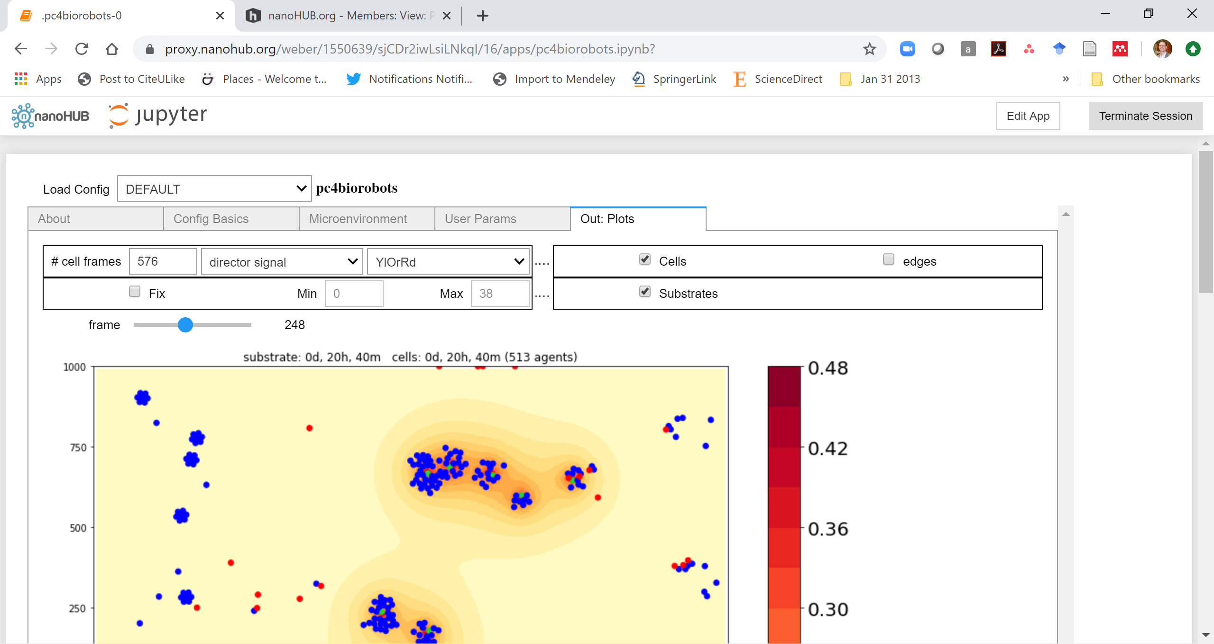
Simulation output
The Out: Plots tab shows the simulation outputs as it runs.
Slide the "frame" bar to advance time in the simulation.
Use the dropdown box to choose a different substrate for visualization.
Use "fix" to manually set the plot range
Click the righthand dropdown box to change coloring (YIOrRd, viridis, jet, …)
The checkboxes on the right let you choose plotting options for the cells.
Note: Some older apps may split the output into separate "substrate" and "cell" tabs, rather than overlay them.

Slide 13
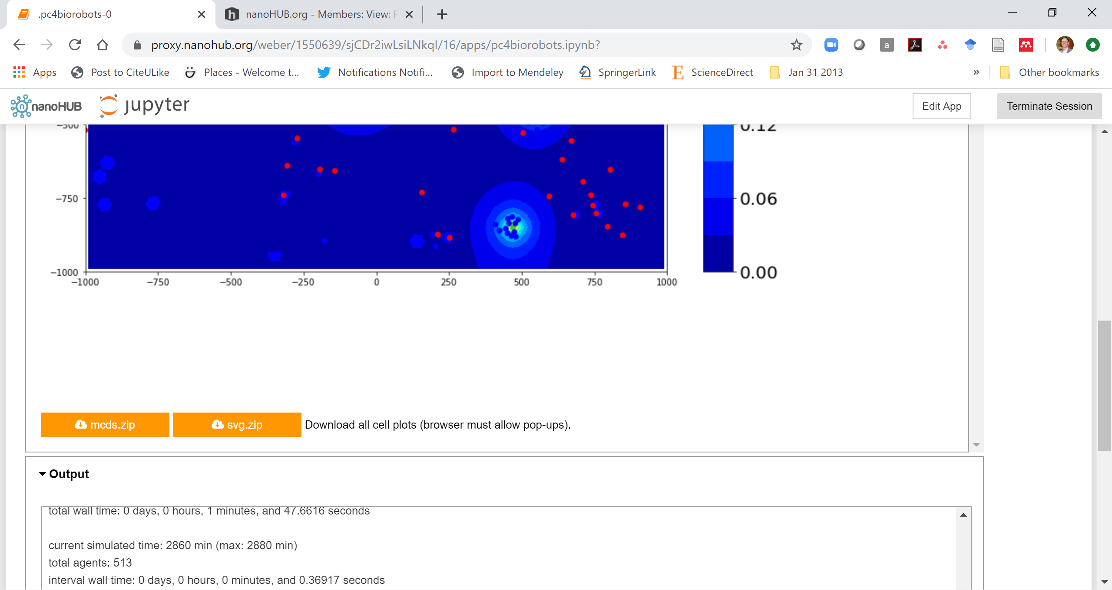
Downloading simulation plots and data
At the bottom of the output tab, you can find options to download your simulation data.
Click svg.zip . to download all the SVG cell plots as a single ZIP file.
Click mcds.zip . to download all the simulation data (in MultiCellDS format) as a single ZIP file.
Note: These download buttons only work after a simulation has finished running.
See the PhysiCell-Tools ecosystem for tips on loading simulation data in Matlab, Python, and other environments.

Slide 14
Live demo
https://nanohub.org/tools/pc4biorobots

Slide 15
Next steps
Super fast: Please proceed to 4 (Introduction to PhysiCell) link: https://github.com/physicell-training/04-PhysiCell-intro
Intermediate: Please proceed to 4 (Introduction to PhysiCell) link: https://github.com/physicell-training/04-PhysiCell-intro
Full training: Please proceed to 3 (What is an agent-based model?) link: https://github.com/physicell-training/03-What-is-ABM
More lessons: https://github.com/physicell-training/master-list

Slide 16




Credits
Lesson Planning: Paul Macklin, Drew Willis*, Randy Heiland
Slides: Paul Macklin, Drew Willis, Randy Heiland
Recording: Paul Macklin, Drew Willis*
Post-production: Paul Macklin, Drew Willis*, Kali Konstantinopoulos*
Microapps: https://www.nanohub.org/tools/pc4biorobots
* denotes undergraduate researcher
Funding:
PhysiCell Development:
Breast Cancer Research Foundation
Jayne Koskinas Ted Giovanis Foundation for Health and Policy
National Cancer Institute (U01CA232137)
National Science Foundation (1720625)
Training materials:
* Administrative supplement to NCI U01CA232137 (Year 2)

